Slide 1


Ron Williams
Website Revamp And Digital Umbrella Creation
Created By:

Slide 2

Contents
Goals & Strategy
New Content
Charting The Customer Journey
Wireframes
Mobile-Optimized Wireframes
Future Plans

Slide 3
Goals
Keep visitors from quickly bouncing off our pages
Make library of information more accessible
More informative pages
To be more visually aligned with our brand
Improve navigation to average more pages per visit
Improve on-site SEO

Slide 4


Slide 5




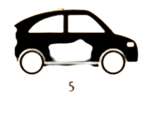
Evolutionary Site Rollout
Less risky approach involves a process of testing with incremental improvements.
Creates a system of continuous improvement
Produces a better visitor experience

Slide 6



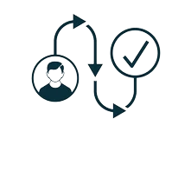
Strategy
Rephrased messaging
Clearly outlined goals and tasks
Contiguous feedback loop
Focus on customer journey

Slide 7
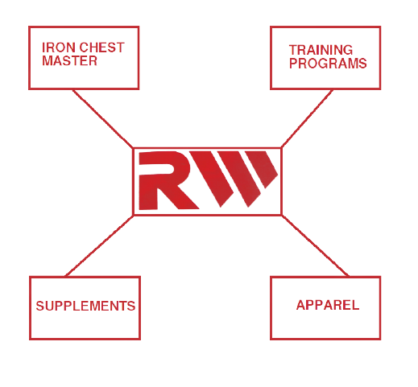

Slide 8
New Content
Photographs of Ron Williams - Working up a sweat with cardio - Pumping iron, flexin’ - Meal prep and mixing workout supplement drinks
Fast-paced quick-cut videos of RW work outs
Archival video footage of RW flexing at competitions
High-energy graphics for backgrounds that inspires and motivates people
Training content

Slide 9
Charting The Customer Journey
AIDA principles as a guide to developing the user interface
ATTENTION
INTEREST
DESIRE
ACTION

Slide 10




???

Slide 11
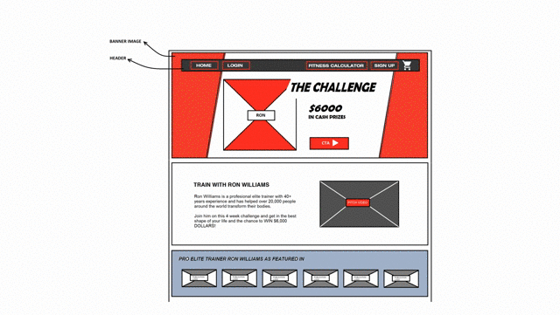
Wireframes

Slide 12
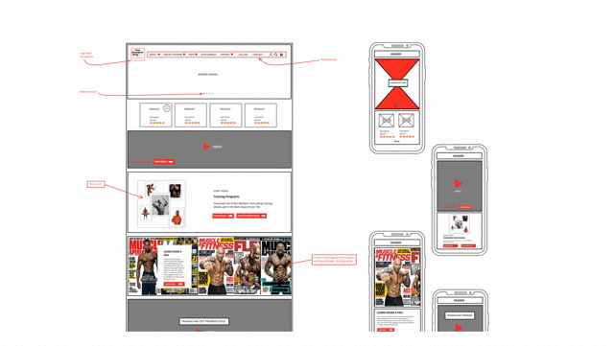
Mobile-Optimized Wireframes

Slide 13
Future Plans
Apparel:
- T-shirts, jerseys, tank-tops, vests, shorts, hats, shoes - Face-masks, wristbands
Inventory - Belts & bags - Shaker bottle
RW Training Mobile App

